Slide 1

Network Layer Protocols
Associate Professor
Department of Computer Science and Engineering

Slide 2
Topics of Discussion
In this session we will learn the following
Network Layer Protocols
IPv4
ICMP
IPv6

Slide 3
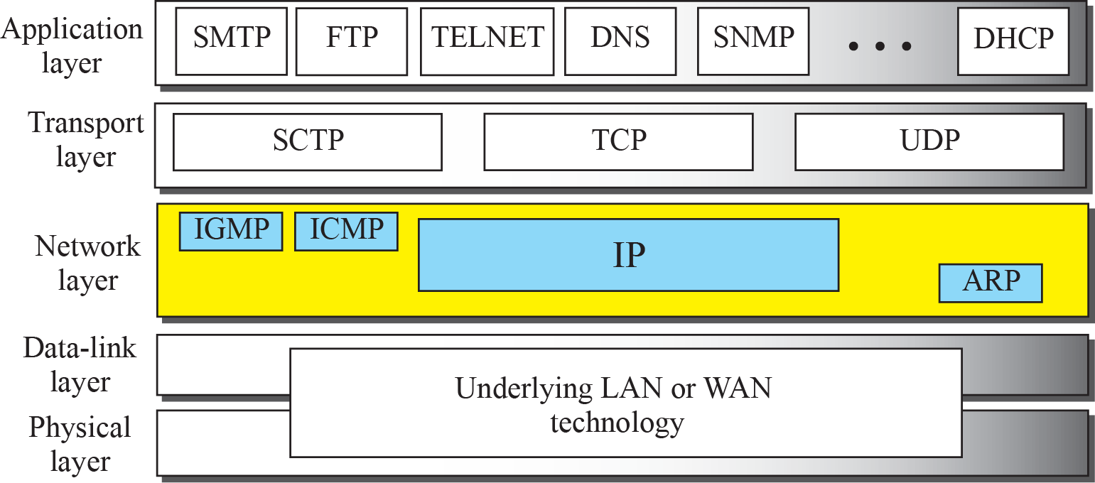
Network Layer Protocols
The network layer in version 4 can be thought of as one main protocol.
IPv4, is responsible for packetizing, forwarding, and delivery of a packet.
The ICMP(Internet Control Message Protocol) v4 helps IPv4 to handle some errors that may occur in delivery.
The IGMP (Internet Group Management Protocol ) is used to help IPv4 in multicasting.
ARP is used in address mapping.

Slide 4
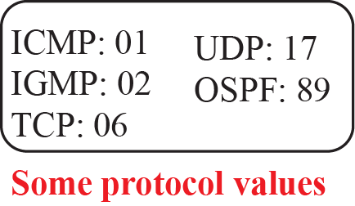
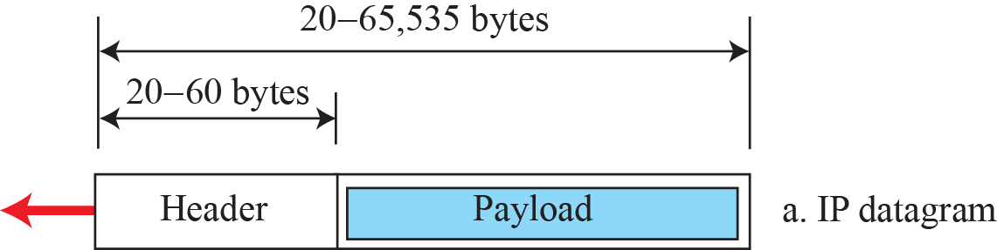
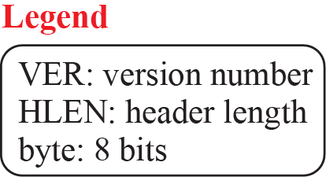
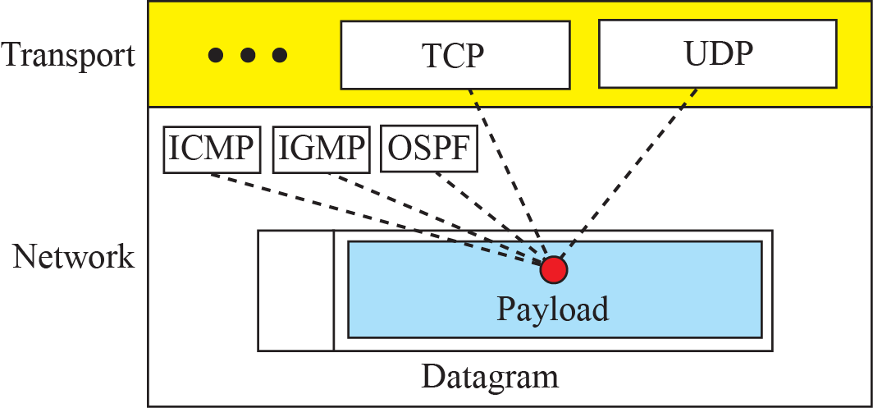
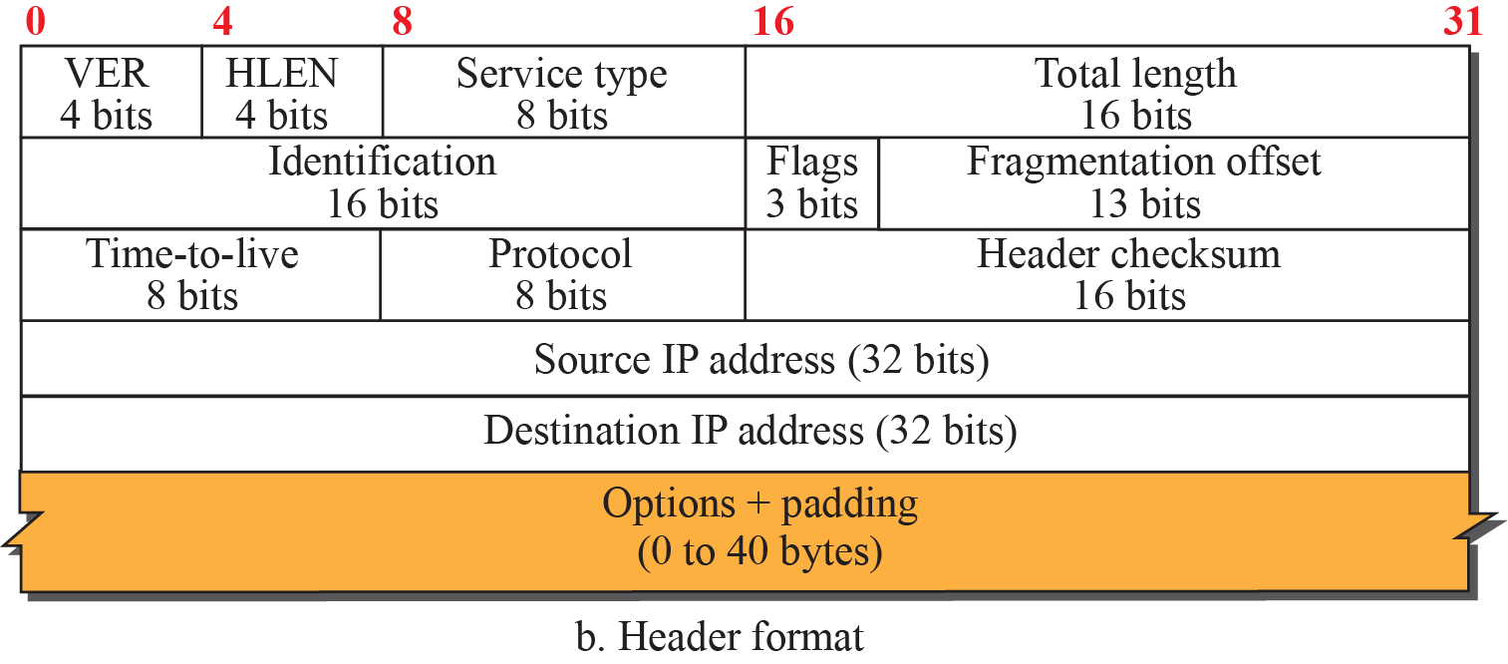
IPv4 protocol
Packets used by the IP are called datagrams. Figure below shows the IPv4 datagram format.
A datagram is a variable-length packet consisting of two parts: header and payload (data).
The header is 20 to 60 bytes in length and contains information essential to routing and delivery.
It is customary in TCP/IP to show the header in 4-byte sections.
a. Multiplexing

Slide 5
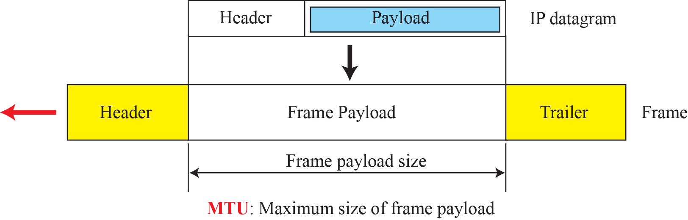
Fragmentation Offset
A datagram can travel through different networks.
Each router decapsulates the IP datagram from the frame it receives, processes it, and then encapsulates it in another frame.
The format and size of the received frame depend on the protocol used by the physical network through which the frame has just traveled.
The format and size of the sent frame depend on the protocol used by the physical network through which the frame is going to travel.
For example, if a router connects a LAN to a WAN, it receives a frame in the LAN format and sends a frame in the WAN format.

Slide 6
Options in the frame format
The header of the IPv4 datagram is made of two parts: a fixed part and a variable part.
The fixed part is 20 bytes long and was discussed in the previous section.
The variable part comprises the options that can be a maximum of 40 bytes (in multiples of 4-bytes) to preserve the boundary of the header.

Slide 7
ICMPv4
The IPv4 has no error-reporting or error-correcting mechanism.
The IP protocol also lacks a mechanism for host and management queries.
The Internet Control Message Protocol version 4 (ICMPv4) has been designed to compensate for the above two deficiencies.
ICMP messages are divided into two broad categories: error-reporting messages and query messages.
The error-reporting messages report problems that a router or a host (destination) may encounter when it processes an IP packet.
The query messages, which occur in pairs, help a host or a network manager get specific information from a router or another host.
For example, nodes can discover their neighbors. Also, hosts can discover and learn about routers on their network and routers can help a node redirect its messages.

Slide 8
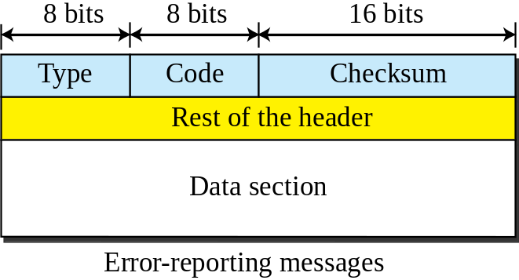
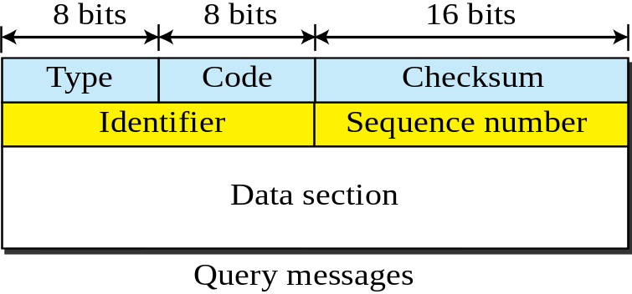
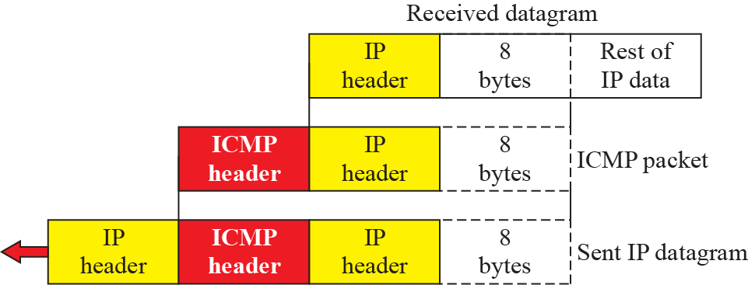
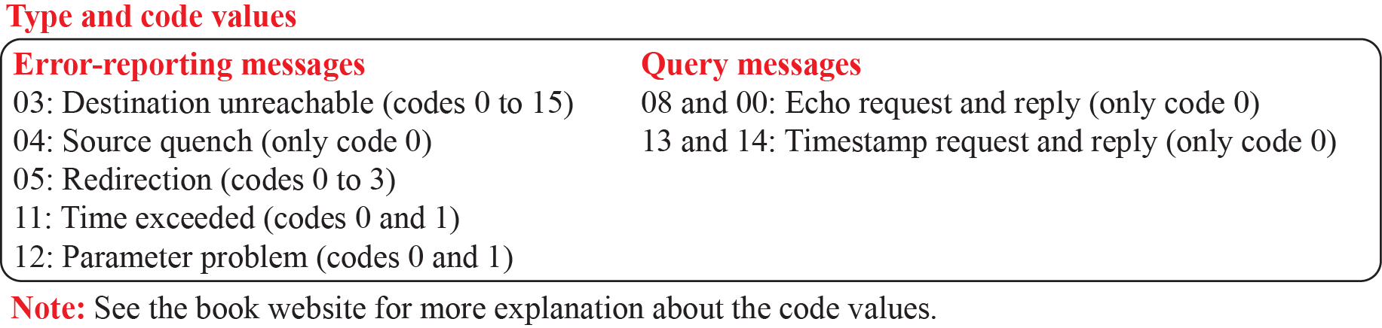
ICMP Message Formats
Contents of data field for the error messages

Slide 9
IPv6 Protocol
The change of the IPv6 address size requires the change in the IPv4 packet format.
The designer of IPv6 decided to implement remedies for other shortcomings now that a change is inevitable.
The following shows other changes implemented in the protocol in addition to changing address size and format.
Packet Format:
The IPv6 packet is shown in Figure below.
Each packet is composed of a base header followed by the payload.
The base header occupies 40 bytes, whereas payload can be up to 65,535 bytes of information.

Slide 10
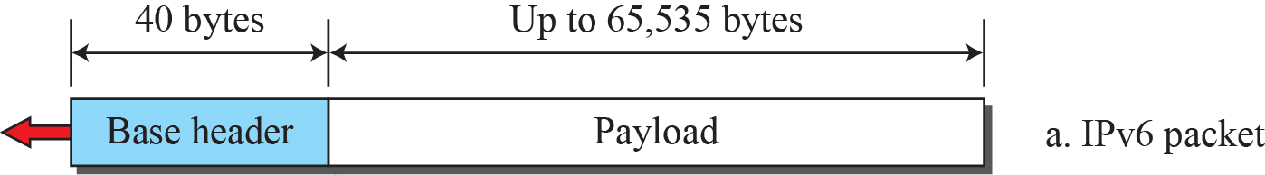
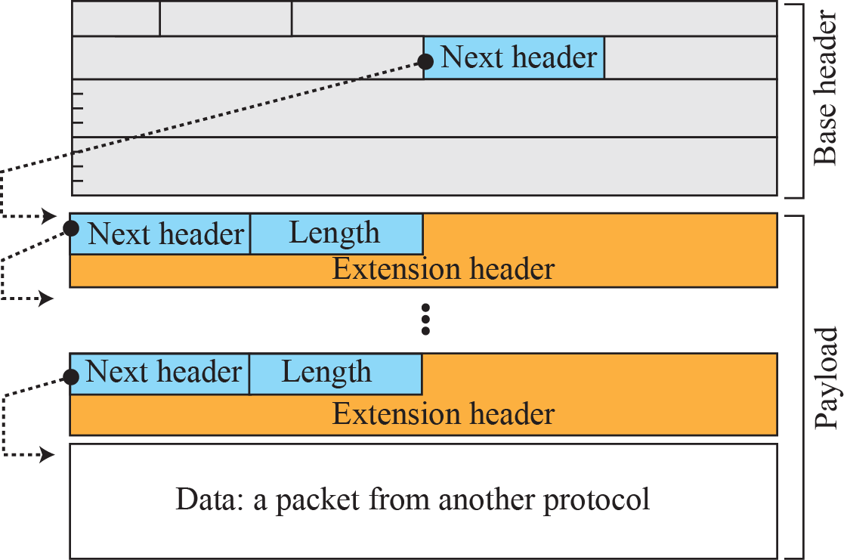
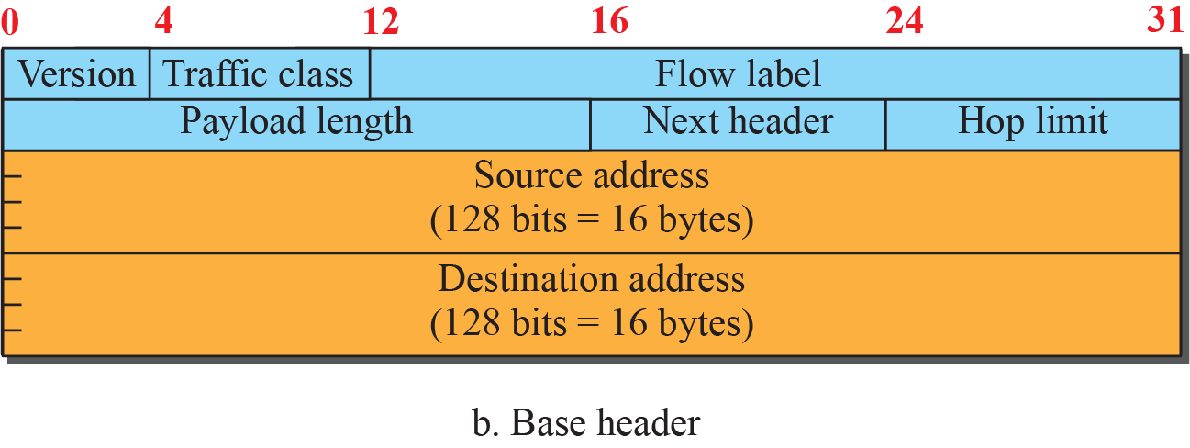
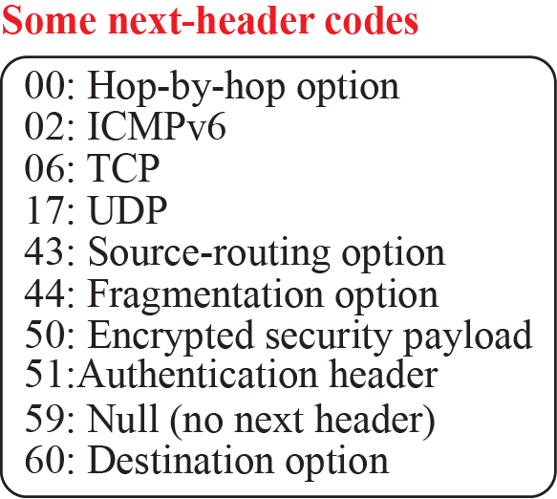
IPV6 Frame Format

Slide 11
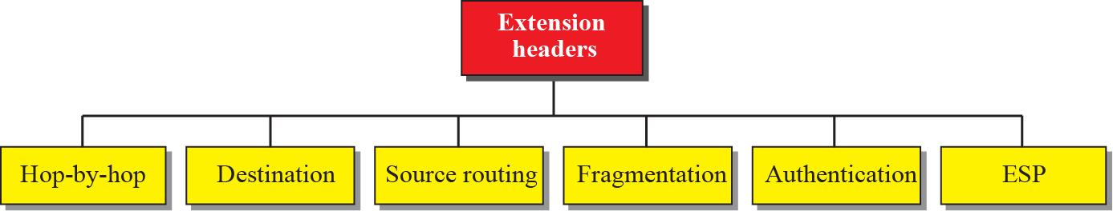
Extension Header
An IPv6 packet is made of a base header and some extension headers. The length of the base header is fixed at 40 bytes.
However, to give more functionality to the IP datagram, the base header can be followed by up to six extension headers.
Many of these headers are options in IPv4.
Six types of extension headers have been defined. These are hop-by-hop option, source routing, fragmentation, authentication, encrypted security payload, and destination option.

Slide 12
Summary
In this section we have discussed the following:
IPv4
ICMP
IPv6
Notes:
1.#

Slide 13

Notes:
1.#

